Slide 1
Exercise 12
Phyla Porifera and Cnidaria

Slide 2
In this lab exercise, you observed the wide diversity of animals in the phyla Porifera and Cnidaria. You will be expected to recognize each group and their distinguishing characteristics. Consult your lab manual for the role of each in its environment, the structures that you will need to recognize on each specimen, and their functions. As in all exercises, concentrate on those structures in bold face type and those that you were asked to label on your diagrams.

Slide 3
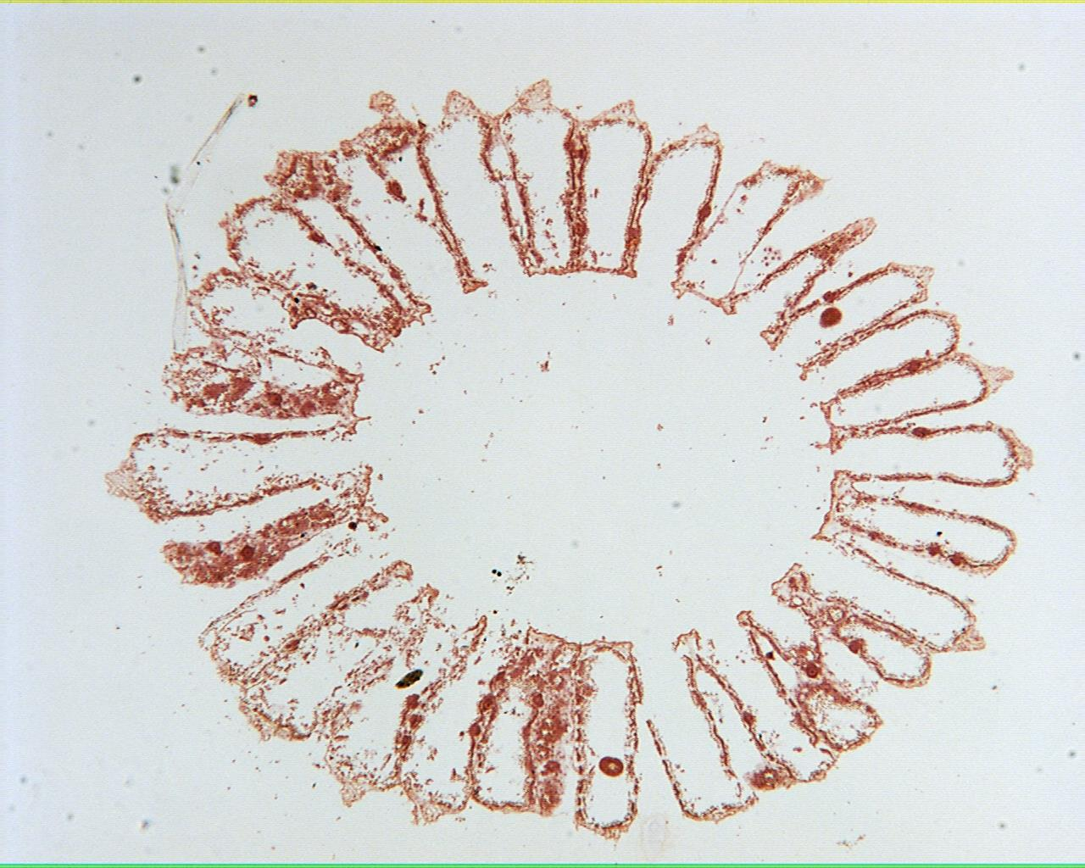
Grantia 40X

Slide 4
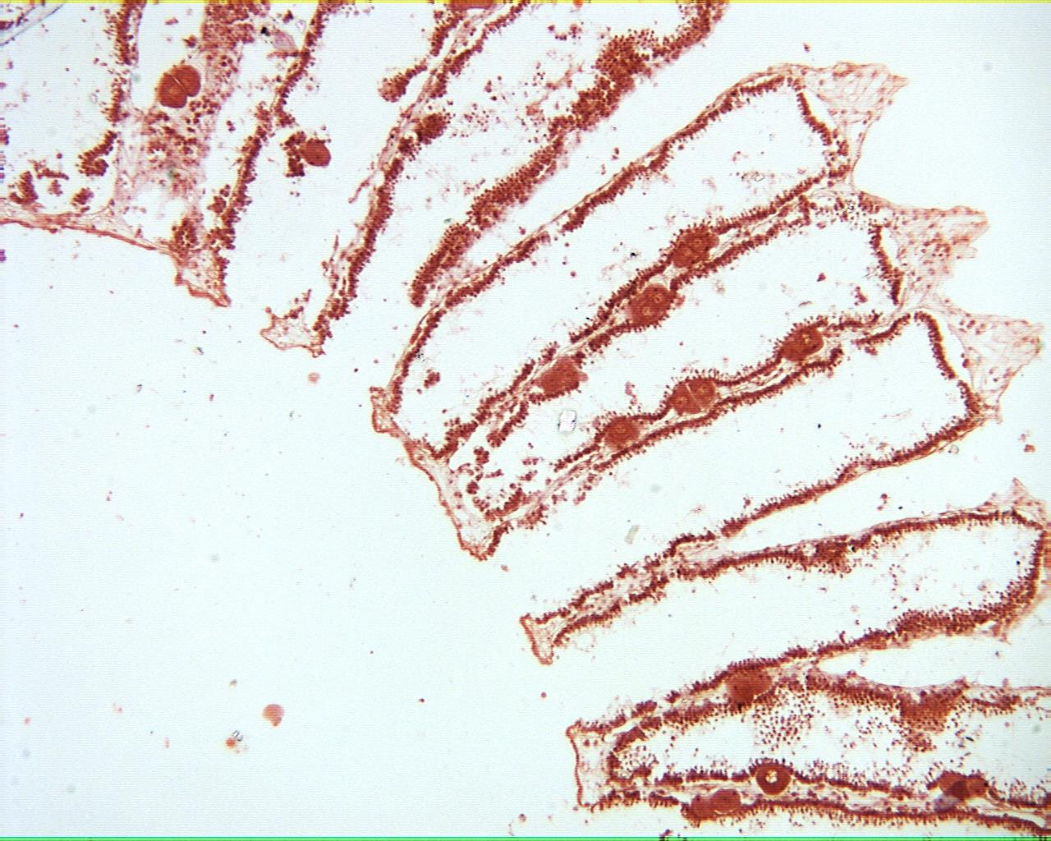
Grantia 100X

Slide 5
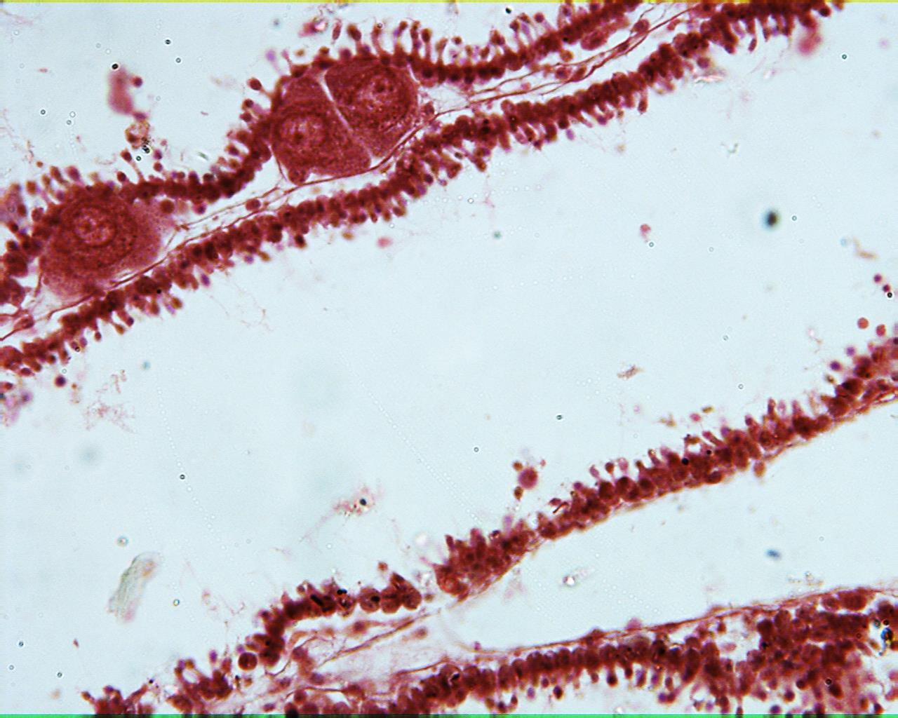
Grantia 400X

Slide 6
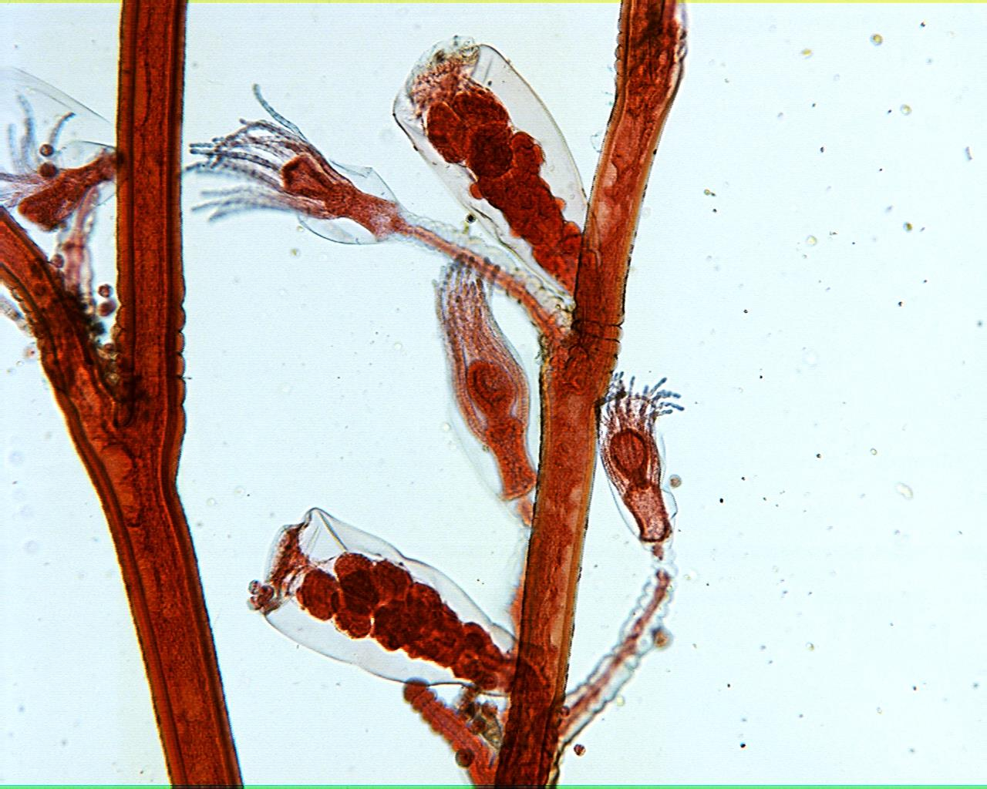
Obelia 40X

Slide 7
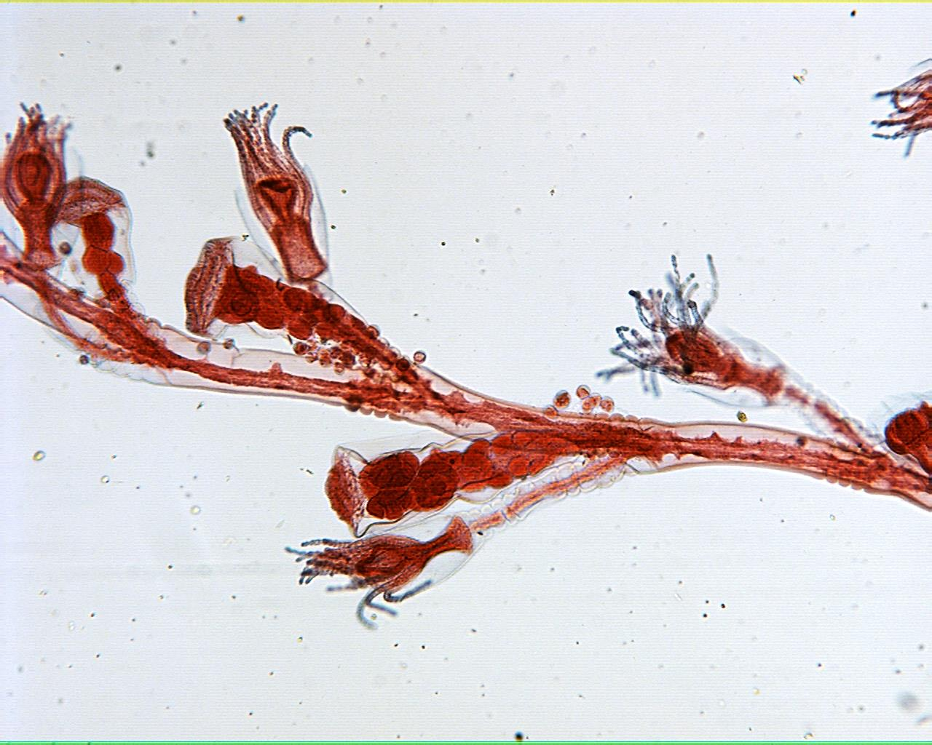
Obelia 40X

Slide 8
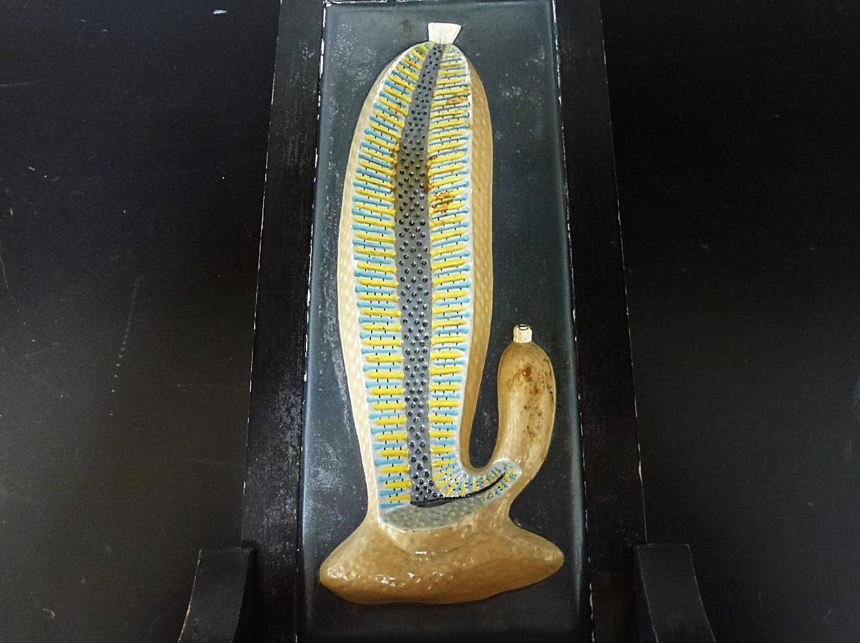
Sponge Model

Slide 9
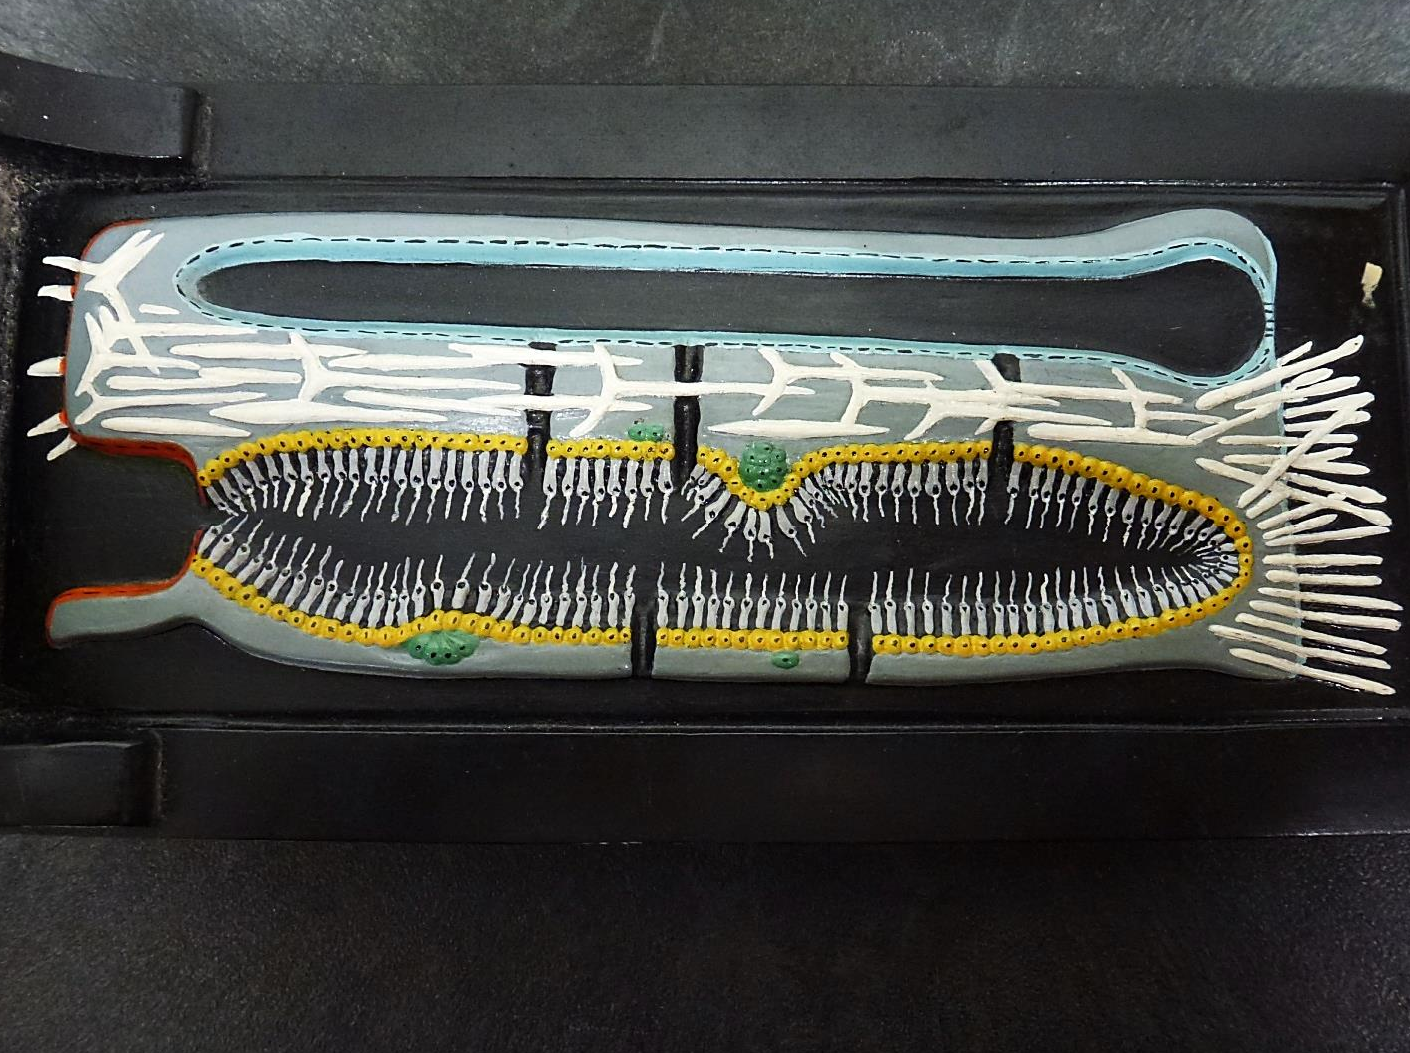
Sponge Canal Model

Slide 10
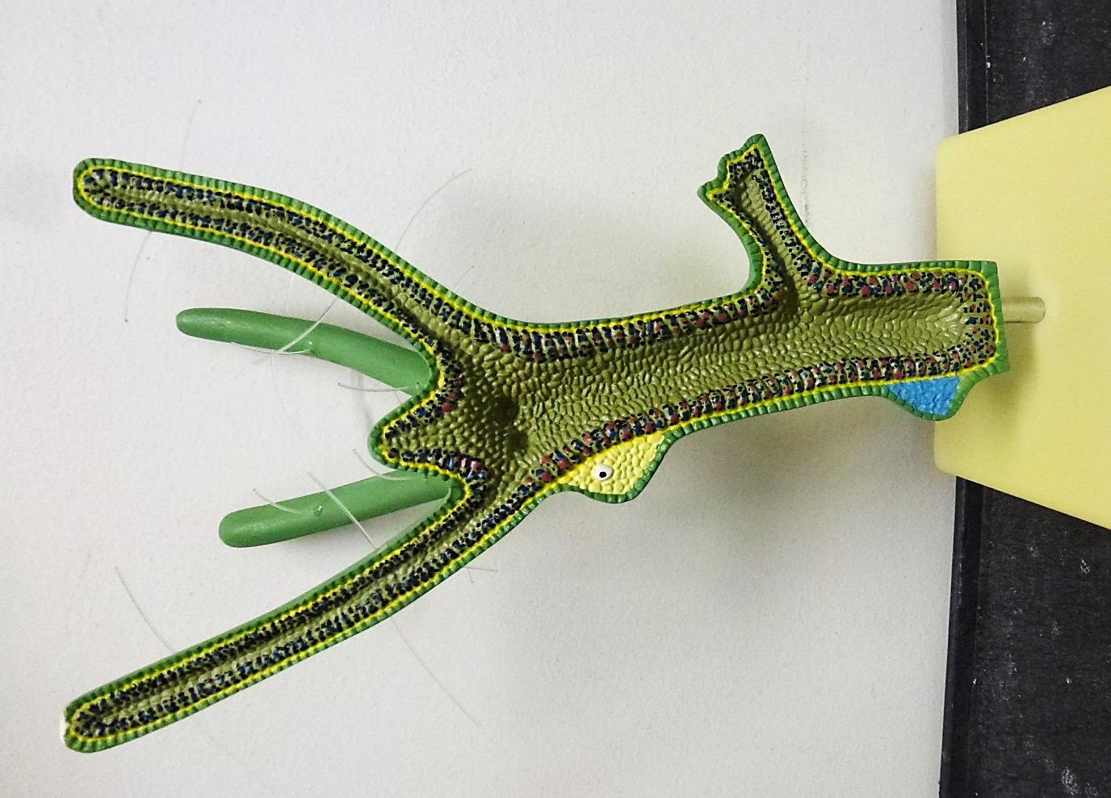
Hydra Model

Slide 11
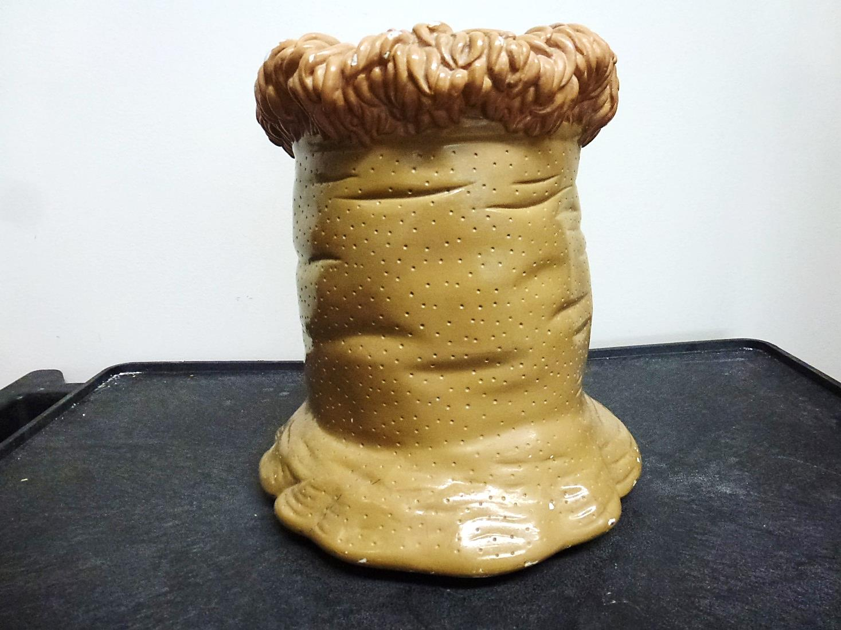
Anemone Model

Slide 12
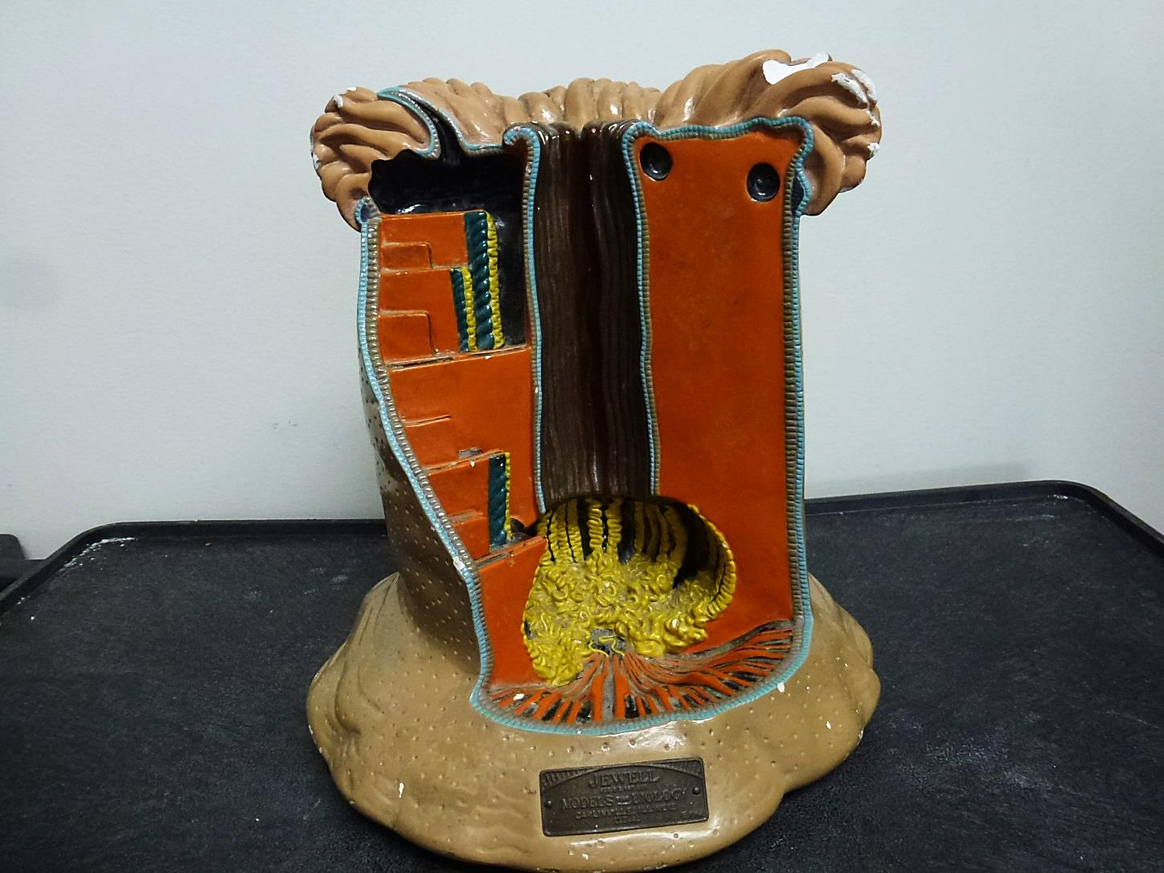
Anemone Model

